Slide 1

Influencing How your Communication is Received
“The greatest ability in business is to get along with others and to influence their actions.” John HancocK

Slide 2

Communication Quality = Transfer Accuracy
3 Major Factors influence accurate transfer:
1 – receiver’s ABILITY to process the message
2 – receiver’s WILLINGNESS to process
3 – receiver’s accurate COMPREHENSION

Slide 3

1 – Receiver’s ABILITY to process
Ability includes:
Listening skills
Overall knowledge
Relevant experience
Intellect
Frame of reference
Most of us truly do not listen; we just wait to talk

Slide 4
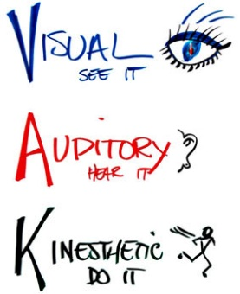
Information Must be “Receiver-Friendly”
People absorb info in 3 ways:
Visually: what we see
Auditorily: what we hear
Kinesthetically: what we do, activity
Do not limit your communication style to one delivery method.
Do not assume everyone processes information the same way.

Slide 5
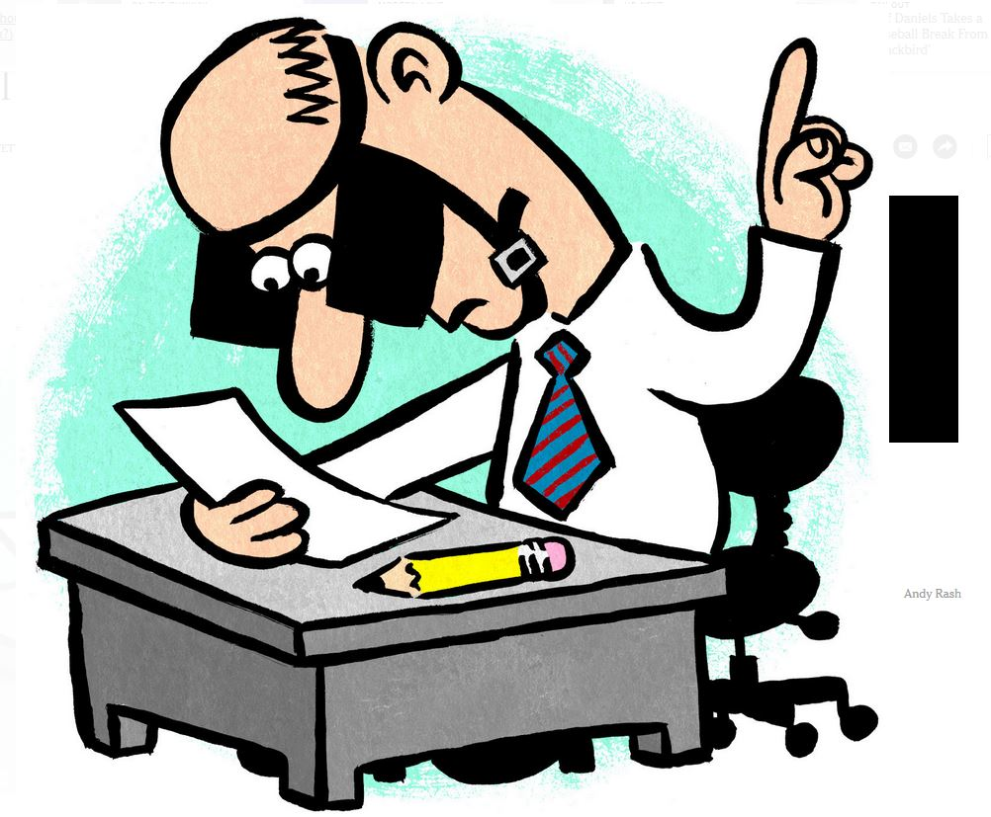
Analytics Professionals
Often are visual learnings
Graphs, charts, written word, visual presentations, tables, schematics, flowcharts…
For auditory learners: Visuals can be overwhelming and confusing to others who have a different learning style
For visual learners: may not have strong listening skills, may want to be involved in the process to comprehend

Slide 6

It’s Your Responsibility
1- Tell them
Face to face or via phone/voicemail
2- Show them
In writing; email, report, summary
3- Involve them
Get them engaged, ask for participation

Slide 7
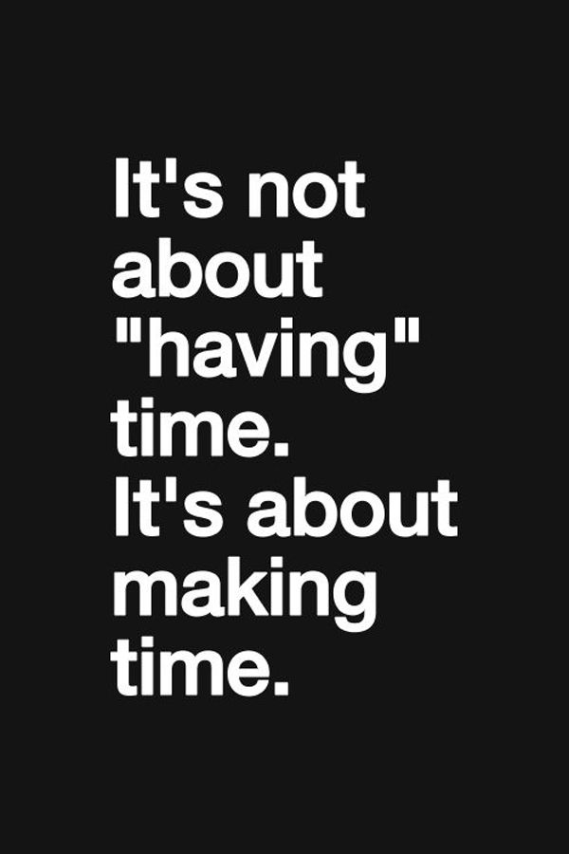
Worth Your Time?
Valuable time spent fixing problems from ineffective communication
Repeating tasks, wasted time on frustration, extra meetings, damage control, venting with colleagues
Tell them, Show them, Involve them = time well spent!
(repetition is also very valuable, to get info multiple ways)
How to determine best communication style? ASK THEM!!
Build a communication agreement!

Slide 8

External Factors
Physical Environment
Potential for disruption, listener is distracted
Try a conference room, or take a walk
Timing
“Is this a good time?”
Productivity Cycle
Morning person? Give options to meet
Be Responsive to Circumstances – is a meeting getting off course, offer to reschedule for a time when external factors are better for communications

Slide 9

2 – Receiver’s WILLINGNESS
1- Use Assertive Communication Style
Use I- and WE- statements, not YOU-
You implies a negative emotional impact leading to the receiver to shut down
Receiver becomes focused on defending themselves
YOU- phrases are preferred when giving praise so that it’s specific to the individual
2- Avoid Provoking Phrases
Sends a message of devaluing the other’s message, dismissive, argumentative, disagreement
Example:
“I appreciate the information you sent me, but it’s incomplete.”
OR: “I appreciate the information you sent me, and there’s some additional things I need.”

Slide 10
3- Receiver’s ACCURATE COMPREHENSION
Your Communication
Meaning can become distorted at any point, varies person to person
Factors:
Education
Experience
Age
Culture
Gender
Language
Comprehension Barriers
Comprehension of the Message

Slide 11

Factors that Influence Transfer of Info
Education and Experience
If you communicate above their level it can intimidate or overwhelm others
If you communicate below their level it can make the receiver resentful or you could be perceived as arrogant, condescending
Culture
US / Western Cultures – stress individualism
Majority of world – stresses collectivism
Body language differences: mostly spacing and eye contact
Age
There are often negative judgements made about each generation
Work ethic / dedication
Work / life balance
Use appropriate analogies
Ex: “broken record” is clear to a Baby Boomer, but a millennial may have never seen a record

Slide 12
GENDER: Influential Factor
Generally:
Men – interpret situations as more competitive, hierarchical
Women – perceive situation more collegial, participative perspective
Men – single task oriented
Women – multi-taskers
Intent:
Men - Establish uniqueness
Women – promote inclusion
Apologies:
Men tend not to apologize whereas women do, and may actually be expressing concern/sympathy, not admission of error
Content:
Men focus on sharing info objectively, mostly facts and observations
Women develop interaction or rapport almost equal information which leads to greater tendency to discuss emotion, thoughts, feelings

Slide 13
Gender: Influential Factor, Cont’d
Silence:
Men – used for emphasis, assert power
Women – used to introspection, pondering
Often misunderstood for weakness, uncertainty
Physical Positioning:
Men – prefer to sit side-by-side
To face each other subconsciously signals confrontation or intimidation
Women – prefer to sit face-to-face
Enhance interaction and connectedness, enhances partnering
Language:
Use gender-nonspecific language
Examples:
Salesperson, not salesman
Police officer, not policeman
Spouse, not husband/wife
Never use “boys” or “girls” to discuss adults in the workplace

Slide 14

Check for Comprehension
Ask the receiver(s) to summarize
Gives you the opportunity to repair the communication, avoid misunderstanding
3 Common Issues:
Assuming success
Negative Past Experience
Inaccurate verification

Slide 15

Ask for Receivers to Summarize
Do so assertively, not aggressively
“I want to be sure that you understood what I discussed with you, could we review together?”
“I want to be certain I’ve done a good job of communicating, help me out. Can we summarize what we discussed in the meeting?”
You could add: “I can fill in any gaps if I wasn’t clear.”
Don’t challenge them, discover comprehension level

Slide 16

Keys to Ensure Comprehension
Must be in their own words
If inaccurate: assume you did not communicate effectively
Explain again in a NEW method
Don’t respond negatively
Summarizing will soon become habit
Less threatening, more constructive
OFFER to summarize to others to ensure you comprehend messages

Slide 17

Let me check for Comprehension
3 Major Factors influence accurate transfer:
1 – receiver’s ABILITY to process the message
2 – receiver’s WILLINGNESS to process
3 – receiver’s accurate COMPREHENSION
Check for comprehension!

Slide 18
Public Speaking
A good speech is like a pencil; it has to have a point!

Slide 19
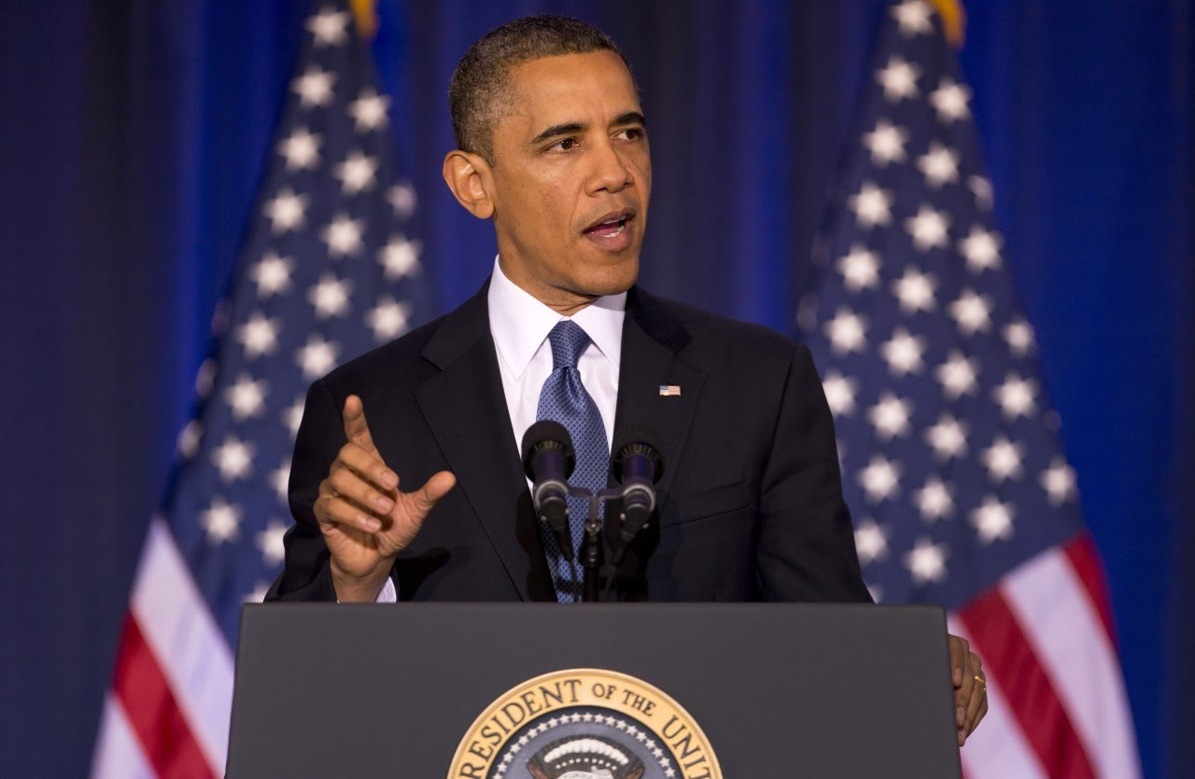
Before You Begin Speaking
Don’t wing it…
Practice! You can practice in front of a mirror, record yourself and play it back, or in front of friends/family
Be aware of your body language
Think positively!
You’ll be nervous but harness that!

Slide 20

When You’re Speaking
Mistake? Tongue tied? Just repeat yourself with what you meant to say
Fake it ‘till you make it –project that you have confidence and you’ll slowly gain it
Harness your excitement! If you’re nervous/excited it’s okay to show that to some degree to excite the audience

Slide 21
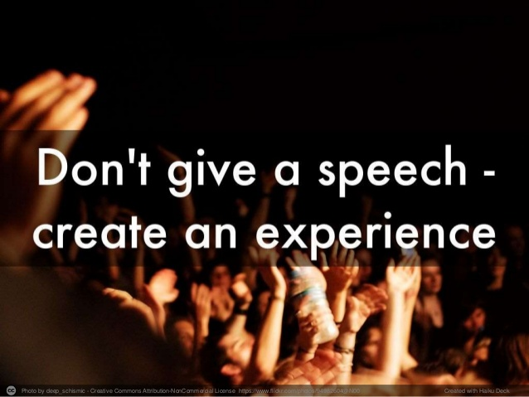
When You’re Speaking
Ask questions of the audience – get them engaged
Use your hands or walk around the room to loosen you up
If your presentation has a lot of numbers and statistics then try not to read them all, audiences will tend to gloss over – you don’t want anyone to fall asleep!
Show, don’t tell the figures.
Keep track of time

Slide 22
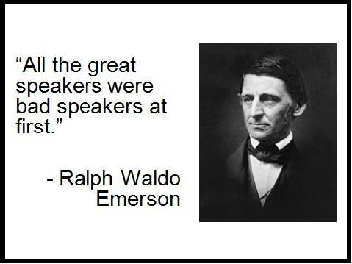
Psychological Factors
They audience wants you to do well! This is their time that they are investing
We are instinctually hard-wired to follow leaders. When you’re public speaking you are instantly given authority
Amy Cudy’s TED Talk – power pose
Most people learn better through listening, not reading – let the slides support statements, not lead
When you’re nervous you make others around you nervous, a calming demeanor can have the same affect on the listeners

Slide 23
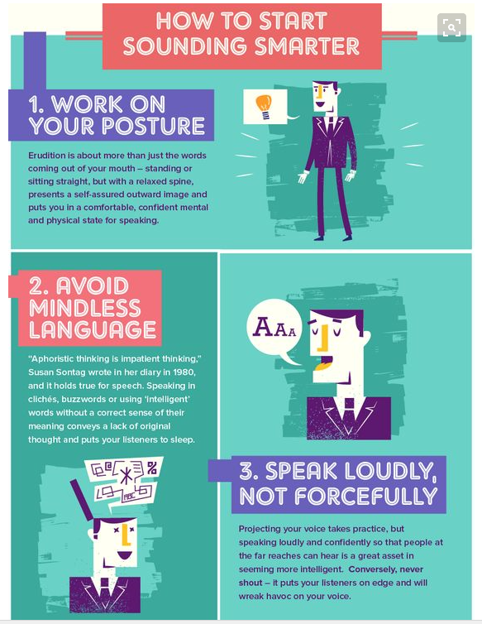
Focus on your style of speaking

Slide 24

After You’re Done Speaking
Let the audience know how much time you plan to give them for Questions & Answers
If there are tons of questions offer to follow up via email with anyone you can’t get to right them
If you don’t get any questions don’t fret – try to stand still for up to half a minute (which will feel long)

Slide 25

After You’re Done Speaking
When done simply say “Thank you” to let the audience know
Be available to take questions.
Some might be nervous about speaking in front of others - prefer to ask you one on one.

Slide 26

Other Advice…
For a scripted speech change the color of font every 4 lines
Avoid Apologies, “sorry for the technical difficulties” or “sorry to keep you waiting” – simply state facts or give updates but maintain your composure
Make eye contact with audience members one by one, it makes them feel connected. Also a good way to recover someone who seems to have checked out (just a few solid seconds)
Think about when you sit through a good presentation of others – what makes it successful? What elements would you want to emulate?

